Slide 1
Web Site Design for E-Commerce
Bebo White
Stanford Linear Accelerator Center
bebo@stanford.edu

Slide 2
E-Business and E-Commerce
E-Business: “the conduct of business with the assistance of telecommunications and telecommunications-based tools”
E-Commerce: “the conduct of commerce in goods and services, with the assistance of telecommunications and telecommunications-based tools”
(Ref:: Roger Clarke)

Slide 3
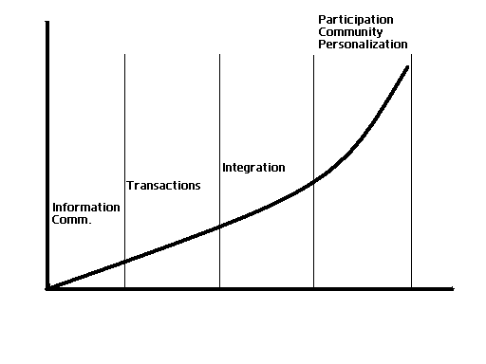
E-Business/Commerce Evolution
Time vs. Complexity of E-Business/Commerce

Slide 4
Usability
“the ease with which a user can learn to operate, prepare inputs for, and interpret outputs of a system or component” - IEEE Standard Computer Dictionary
A key component in Human-Computer Interaction (HCI)
A primary focus in the design of Web sites
A “usability subculture” has evolved as a result of Web technology

Slide 5
Usability Variations
Usefulness, and user experience
Usability engineering and usability method
User-centered design

Slide 6
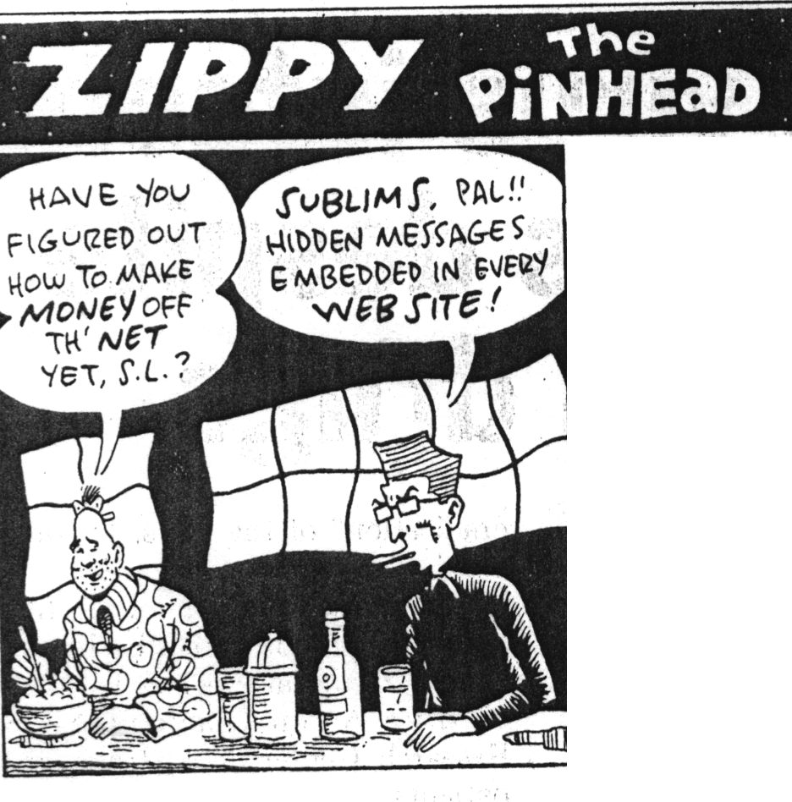

Slide 7
Web Usability Experts
Analyze and critique
  Conceptual models
  Web site navigation schemes
  Web site widgets
  Web page sizes, colors, vocabulary
  Each other
  Blah, blah, blah…
“Church of Usability” - http://builder.com.com/5100-6371-1044594.html

Slide 8
Why Is Usability Important for E-Commerce Web Sites?
Primary interface to customers
Users expect instant gratification
Users experience usability before they are committed to buying
Expectations arise from best site across industries
Competitors are “just a mouse click away”
Value of usability for the time-constrained information seeker
Usability as the critical success factor for Web projects

Slide 9
Why Is Usability Important for E-Commerce Web Sites? (cont)
E-Commerce Web site = electronic storefront
  Web site user interface = electronic clerk
  Online shoppers can afford to be less tolerant with an inept electronic clerk
E-Commerce Web site = electronic catalog for direct sales
  Catalogs are convenient for mail-ordering and large inventory
  Too much focus on display and publicity
  Web site user interface = “read-ability/usefulness” of catalog
  How many paper catalogs get thrown away?

Slide 10
Return On Investment (ROI)
External ROI
  Increased sales
  Decreased customer support costs
  Savings gained from making changes earlier in the design life cycle
  Reduced cost of providing training

Slide 11
ROI (cont)
Internal ROI
  Increased user productivity
  Decreased user errors
  Decreased training costs
  Savings from making changes earlier in design life cycle
  Decreased user support

Slide 12
Myths of Usability ROI
Analog comparisons are not required
  “Cost of bad Web design: Loss of approximately 50% of potential sales from the site as people can’t find stuff” (Jakob Neilsen, Alert Box, 1998, cited by Forrester)
Executives will believe “voodoo economics”
  “There are one billion users on the Internet, and half of them could come to your site. If the average cost of an abandoned shopping cart is $20, then you will lose $10 billion a year in sales of your designer pet food” (Rosenburg, 2003, parody of J. Neilsen)
(Daniel Rosenberg, Oracle)

Slide 13
Conversion Rates
A conversion rate is loosely defined as the percentage of Web site visitors who complete a desired action
This action can take many forms:
  Clicks beyond home page
  Purchases
  Membership registrations
  Newsletter subscriptions
  Sample downloads
  Sales inquiries, etc.
(“Using Conversion Rates to Measure Web Site Effectiveness and Improve ROI”
http://www.websiteprofitdoctor.com/MC_BP_articles.asp?article=03_11_03_01.txt)

Slide 14
Conversion Rates (cont)
A high conversion rate depends on several factors
  The interest level of the visitor
  The attractiveness of the offer
  The ease of the process
The interest level of the visitor is maximized by matching the right visitor, the right place, and the right time
(“The #1 Internet Marketing Metric”
http://www.marketingterms.com/dictionary/conversion_rate)

Slide 15
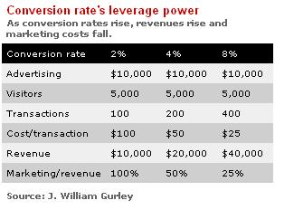
Conversion Rates (cont)
“…average conversion rates are in the 3% to 5% range; below 2% is considered poor; and 10% and above is awesome.”
(http://news.com.com/2010-1071-281288.html)

Slide 16
Conversion Rates – Elements That Affect It
User Interface
Convenience
Performance
Effective advertising
“Word of Mouth”

Slide 17
Conversion Rates Influenced By Many Factors
Target
Inappropriate
Audience
100%
Slow Page
Load
Unclear
Marketing
Message
Clumsy Site
Navigation
Unengaging
“Look & Feel”
Inadequate
Selection
Percent
of Site
Visitors
Ineffective
Presentation
Uncompetitive
Price
No Access
to Real-Time
Help
Long Delivery
Times
Credit Card
Validation
Error
Ineffective Tools to
Assist Selection
Excessive
Shipping Costs
Order
Conversion
Rate = 1.9%
Customer Acquisition
First
Impression
Merchandising and Selection
Checkout Process
Source: The Boston Consulting Group

Slide 18
Conversion Rates Influenced By Many Factors (cont)
Target inappropriate audience (marketing and UCD)
Unclear marketing message (marketing)
Slow page load (usability)
Un-engaging look and feel (usability)
Clumsy site navigation (usability)
Ineffective presentation (usability)
Inadequate selection (usability)
No access to real time help (usability)
Uncompetitive price
Ineffective tools to assist selection (usability)

Slide 19
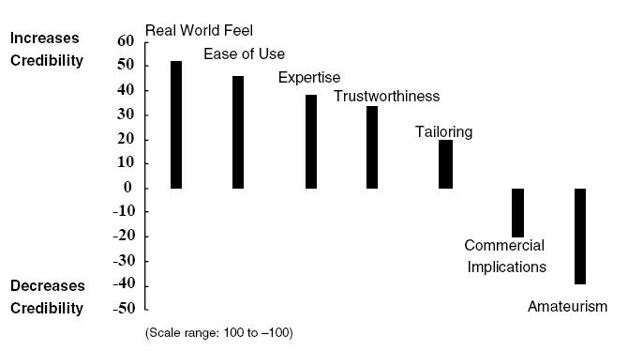
Web Site Credibility Influenced by Similar Factors
(Fogg et. al , Stanford Persuasive Technology Lab @ CHI 2001)

Slide 20
E-Commerce Web Sites Must Be User-Centered
Design should focus on
  User experience – familiar needs and mental models
  User expectations
  User ease and comfort
User-centered design templates can help
  Simplicity
  User control
  Consistent navigation
  Search
  Shopping carts
  Personalization

Slide 21
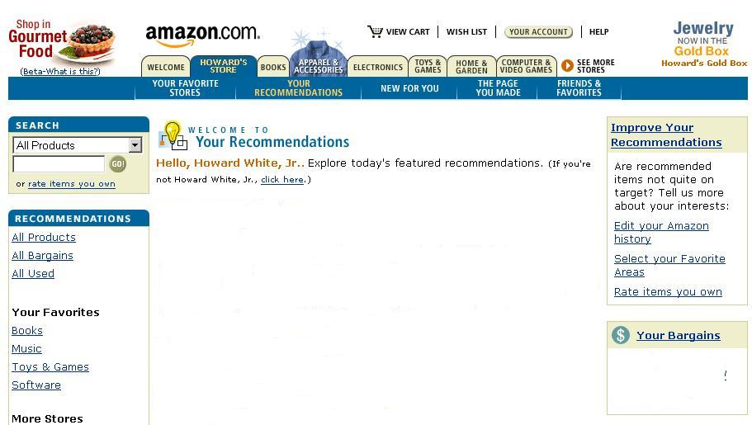

Slide 22
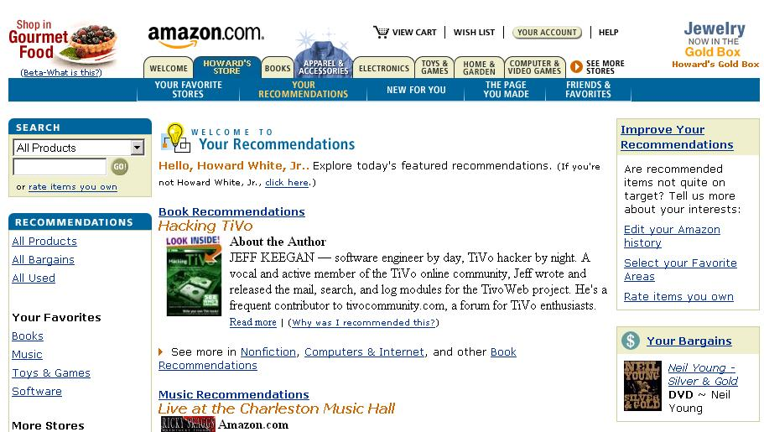

Slide 23
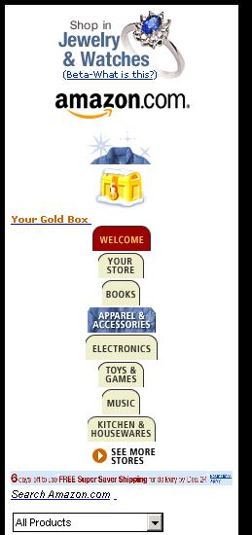
Design Templates Enable Universal Access

Slide 24
Ten Most Violated Homepage Design Guidelines
Emphasize what your site offers that's of value to users and how your services differ from those of key competitors
Use a liquid layout that lets users adjust the homepage size
Use color to distinguish visited and unvisited links
Use graphics to show real content, not just to decorate your homepage
Include a tag line that explicitly summarizes what the site or company does
Make it easy to access anything recently featured on your homepage
Include a short site description in the window title
Don't use a heading to label the search area; instead use a "Search" button
With stock quotes, give the percentage of change, not just the points gained lost
Don't include an active link to the homepage on the homepage
(Jakob Nielsen's Alertbox, November 10, 2003)

Slide 25
What’s Wrong With These Guidelines?
Represent a misconception of important elements of E-Commerce/corporate Web site design (my opinion)
They emphasize design not functionality
They focus on elements not consistency
Usability becomes blurred with marketing

Slide 26
The Future of E-Commerce Web Site Design
User-centered design will become more important in an increasingly competitive market
E-Commerce Web site design must be prepared to accommodate universal access

